Slide 1
Western Countries financial data analysis
Presented By : Rahul Buch

Slide 2
INTRODUCTION
In this project, we delve into the financial data of Western countries to derive insights and recommendations for strategic business decisions.
We follow six key steps :
Ask, Prepare, process, Analyze, Share, and Act.
Let’s dive in !..

Slide 3
Step 1 : Ask
In this step, we define the core business problem : “What are the most profitable products, countries, and segments for Western countries to target or avoid ?”
Business Objectives :
Optimize Profits : We aim to determine how we can optimize the profits.
Identify Emerging Trends : We seek to identify emerging market trends that can give us a competitive edge.
Recommendations : We will use these insights to formulate actionable recommendations for the organization.
Deliverables :
A clear concise summary of business objectives. Compressive documentation of all data cleansing, manipulation, and analysis.
Formulation of recommendations based on our analysis, designed to guide strategic decision-making.

Slide 4


Step 3 : Prepare
In the “Prepare” phase our primary focus is on understanding and assessing the Western Countries Sales Data, which is provided by Skill Academy at this link: Western Countries Financial Data.xlsx. Here’s a concise and organized overview of data set.
Dataset Overview: The dataset comprises of 701 rows dedicated to pure data and one row containing column headers. The recorded data span is two years, starting from 1st September 2023 to 1st December 2014. We’ve chosen to use this date range to represent two years of business activity. The dataset encompasses information about 5 unique countries, 5 unique segments and 6 unique products.
Data Columns: The dataset consists of 16 columns each serving as unique attribute: Segment, Country, Product, Discount_Band,Unit_Sold,Manufacturing_Price,Sale_Price,Gross_Sales, Discounts, Sales, COGS,Profit_Date,Month_Number,Month_Name,Year.

Slide 5
Step 3 :
In the “Process” phase we will ensure that our dataset is well-prepared and cleaned to facilitate for further analysis. We will utilize Excel for this purpose as the data is already in XLSX format.
Data Inspection: We examine the dataset thoroughly in Excel.
Missing Data Check: Conditional formatting helps us to identify and address missing data, which is fortunately not present in our dataset.
Duplicate Data removal: We eliminate duplicate rows, ensuring our data remains concise and unique. Also there are no duplicate data presented in data.
Column Formatting: We ensure proper column formatting across Excel, SQL, and Power BI for seamless analysis. This includes formatting numerical fields like Units Sold, Manufacturing Price, Sales Price, Gross Sales, Discounts, Sales, COGS and Profit to the appropriate number format, eliminating any potential import issues into SQL and Power BI.
Additionally, we convert the Year column from text format to a number format for consistency and clarity in data interpretation.

Slide 6
Step 4 : Analyze
We approach our data analysis in structured process, leveraging Excel, SQL, and Power BI to extract insights and drive informed decision-making. Our methodology consists of:
Excel Statistical Analysis: Extracting key components, using statistical tools, and presenting findings visually.
Excel Graphical Analysis: Developing user-friendly dashboards highlighting insights.
SQL Analysis: Manipulating data with SQL quires for deeper insights.
Power BI Dashboard Development: Integrating data into Power BI, designing dynamics dashboards for reporting.

Slide 7
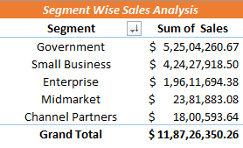
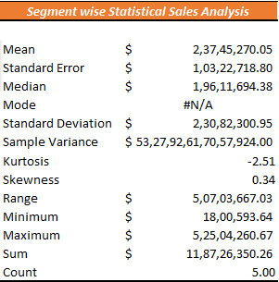
I : Excel Statistical Analysis
Insights from segment-wise statistical sales analysis
Government Segment Leads with $ 52,504,260 in sales
Small Business follows closely with $ 42,427,918
Enterprise Segment contributes $19,611,694
Midmarket and Channel Partners segments show comparatively lower sales.
Statistical analysis highlights variability in segment performance with notable dispersion and a right-skewed distribution.

Slide 8
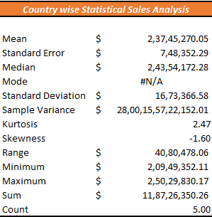
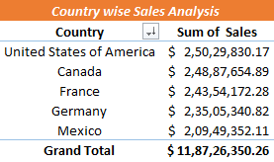
Insights from the Country-wise statistical sales analysis:
USA leads with $25,029,830 followed closely by Canada.
France and Germany also contribute significantly to total sales.
Mean sales amount aligns with the France sales figure , indicating consistent performance.
Standard deviation and sample variance suggest variability in sales across countries.
Possible kurtosis indicates a relatively peaked distribution, while negative skewness suggests a left-skewed distribution of dales data.

Slide 9
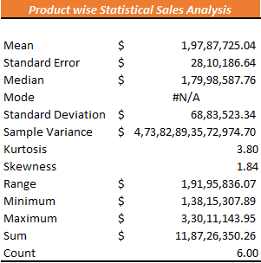
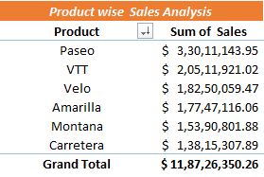
Insight from Product-wise Statistical Sale Analysis:
Paseo leads in sales with $33,011,143 VTT follows with $20,511,921 in sales, contributing significantly to the total Mean sales amount $19,787,725 indicating average performance.
Wide range between the Max and Min Sales figure suggest variability in product performance.
High positive kurtosis and skewness values indicate a distribution skewed towards higher sales figures, with a relatively sharp peak.

Slide 10
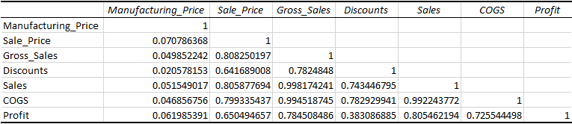
Correlation Analysis of Manufacturing Price, Sale Price, Discounts, Sales, COGS, Profit is :
Strong positive correlation between Sale Price and Gross Sales (0.8083), Indicating higher price correlate with higher sales revenue.
Moderate negative correlation between Discount and Gross Sales (-0.7825), implying discounts may reduce overall revenue.
String positive correlation between Sales and Gross Sales (0.9982), suggesting most sales directly contribute to gross sales.
Strong positive correlation between COGS and Gross Sales (0.9943), indicating higher sales are associated with higher production costs.
Moderate positive correlation between Profit and Gross Sales(0.7845),indicating higher sales contribute to improved profitability.

Slide 11
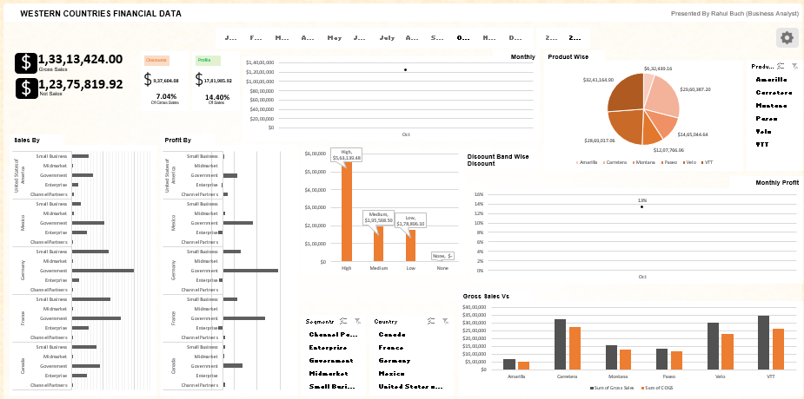
EXCEL PIVOT DASHBOARD

Slide 12
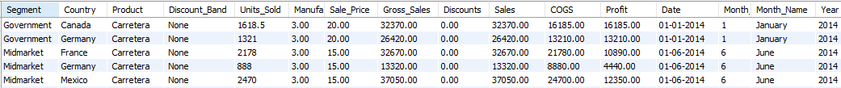
SQL Analysis:
Let's load our data into SQL and check the first 5 rows to make sure it imported well by running below query.
Select * from western_countries_financial_data;
In our exploratory data analysis the western countries financial data, we’ll focus on data to analysis insights. We are using SQL Workbench for our analysis. Through SQL queries we’ll answer critical questions, helping us gain a deeper understanding of the dataset. These insights will be pivotal in addressing the business problem effectively.

Slide 13
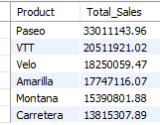
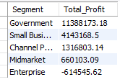
SQL Analysis:
Product Wise Sales
Select Product, Round(Sum(Sales),2) As Total_Sales
From western_countries_financial_data
Group by Product
Order by Total_sales Desc;
Segment Wise Profit
Select Segment, Round(Sum(Profit),2) As Total_Profit
From western_countries_financial_data
Group by Segment
Order by Total_Profit Desc;

Slide 14

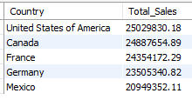
SQL Analysis:
Yearly Sales
Select Year, Round(Sum(Sales),2) As Total_Sales
From western_countries_financial_data
Group by Year
Order by Total_Sales Desc;
Country Wise Sales
Select Country, Round(Sum(Sales),2) As Total_Sales
From western_countries_financial_data
Group by Country
Order by Total_Sales Desc;

Slide 15


SQL Analysis:
Yearly Profit
Select Year , Round(Sum(Profit),2) As Total_Profit
From western_countries_financial_data
Group by Year
Order by Total_Profit;
Top 2 Countries
Select Country, Round(Sum(Sales),2) As Total_Sales
From western_countries_financial_data
Group by Country
Order by Total_Sales Desc
Limit 2;

Slide 16
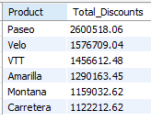

SQL Analysis:
Bottom 3 Products
Select Product , Round(Sum(Sales),2) As Total_Sales
From western_countries_financial_data
Group by Product
Order by Total_Sales
Limit 3;
Product Wise Discount
Select Product, Round(Sum(Discounts),2) As Total_Discounts
From western_countries_financial_data
Group by Product
Order by Total_Discounts Desc;

Slide 17
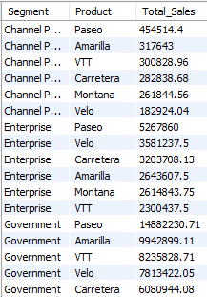
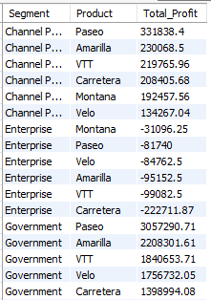
SQL Analysis:
Segment Wise Product Sale
Select Segment, Product, Round(Sum(Sales),2) AS Total_Sales
From western_countries_financial_data
Group By Segment, Product
Order by Segment,Total_Sales desc;
Segment Wise Product Profit
Select Segment, Product, Round(Sum(Profit),2) AS Total_Profit
From western_countries_financial_data
Group By Segment, Product
Order by Segment,Total_Profit desc;

Slide 18
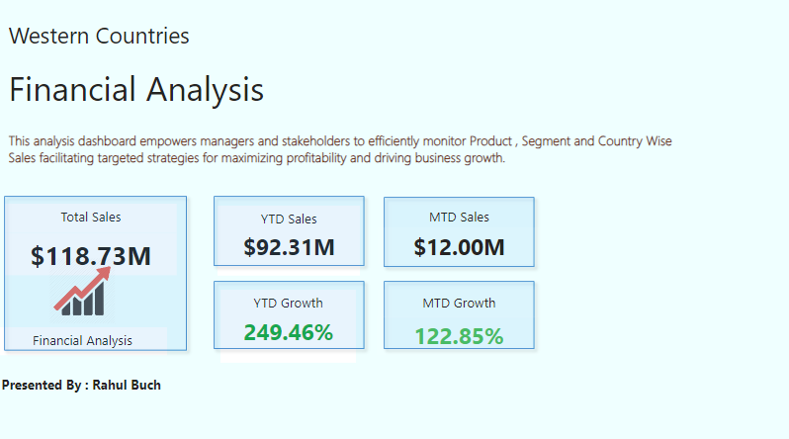
Power BI Dashboard Development

Slide 19
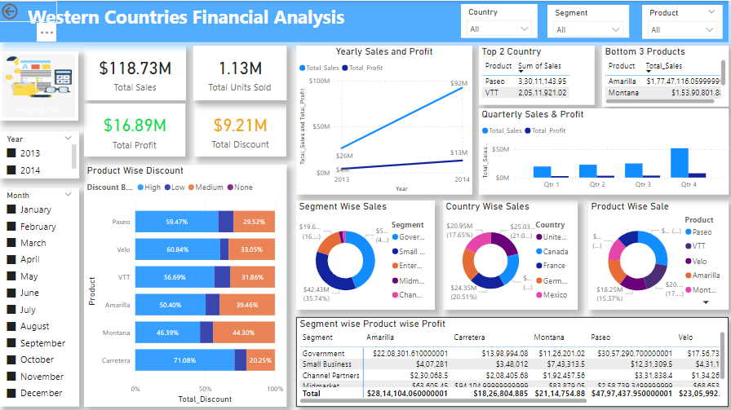
Power BI Dashboard Development

Slide 20
Step 5 :
The main drivers behind our sales growth are the strong performance of products like ‘Paseo’ and ‘VTT’, particularly in Government and Small Business Segments.
By focusing on high-profit-margin products like ‘Paseo’ and ‘Velo’, implementing targeted marketing campaigns, and optimizing pricing strategies, we can enhance overall profitability.
We can conduct further market research to understand the underlying factors influencing profit margins in each country. Tailoring our products offerings and pricing strategies to meet the specific needs of each market can help in improve profitability.
We can analyze the effectiveness of discounts by tracking their impact on sales and profitability. Implementing targeted discounts based on customer segmentation and purchasing behavior can help in maximize sales while minimizing the impact on profitability.
Identifying areas of inefficiency in our supply chain and production processes can reduce COGS. Implementing cost-saving measures, negotiating better suppliers contracts, and optimizing inventory management can contribute to improved margins.
Key action items include focusing on high-performing products and customer segments, optimizing pricing and discounting strategies, conducting market research to understand regional differences, and improving operational efficiency to enhance profitability and drive overall business growth.

Slide 21
Step 5 : Share
In the ‘Act’ phase we’ll translate insights into action.
Execute Strategies : Launch targeted marketing campaigns, optimize pricing and refine discounting strategies.
Enhance Operations: Streamline processes, reduce costs, and improve efficiency throughout the supply chain.
Allocate Resources: Assign roles, provide training, and establish clear accountability for executing the action plan.
Foster Innovation: Encourage experimentation, invest in technology, and foster a culture of collaboration and agility.
Monitor Progress: Establish regular checkpoints, track KPIs, and adapt strategies based on feedback and market dynamics.

Slide 22
Conclusion
Through compressive data analysis and visualization, we've uncovered valuable insights into the financial landscape of Western Countries. Our findings provide actionable recommendations for maximizing profitability and strategic growth opportunities. This project demonstrates the power of business analysis in driving informed decision-making.
Feel free to customize the content further according to your specific project details and preferences.

Slide 23
THANK YOU…

